Slide 1
Testing Types

Slide 2
Agenda
1. Testing groups
2. Detailed description of the each type of testing
3. Advantages and disadvantages of using different types of testing
4. Examples of the kinds of testing
5. Description of the testing process

Slide 3
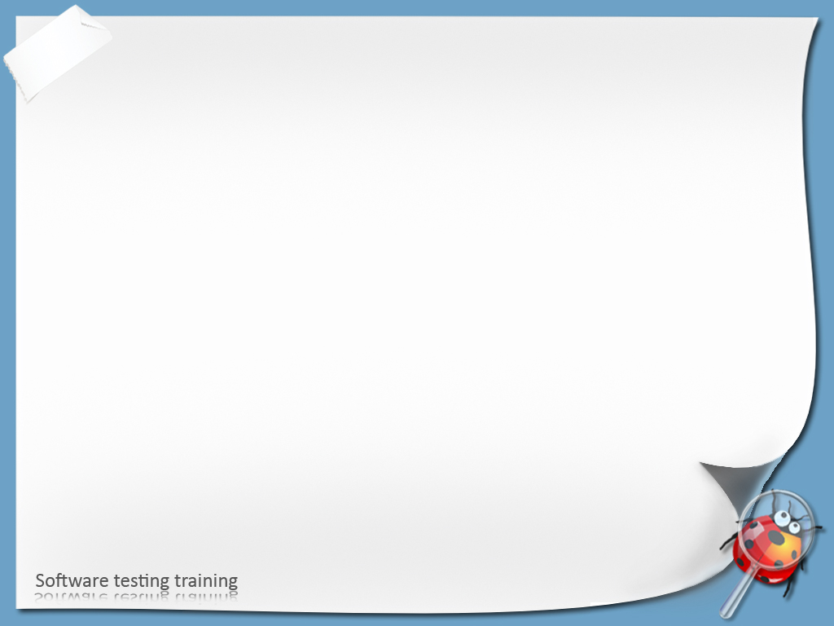
Common groups of testing
By isolation level
By automation
By testing object
By knowledge of the system
By the time of the testing

Slide 4
By Isolation Level
Unit testing
Acceptance
System
Integration testing
Integration
System testing
Unit
Acceptance testing

Slide 5

Unit testing
Goal:
Isolate each part of the program and show that the individual parts are correct.
Usually performed by developers.
locate error in smaller region
reduces debugging affords
Example: 2 + 2

Slide 6

Integration testing
Goal:
This is testing two or more program parts or modules together with the intent of finding interface / interaction defects between the modules or parts.
Server with business logic layer
Database
Client (UI)

Slide 7

System testing
System as whole
Testing the fully integrated applications including external peripherals in order to check how components interact with one another and with the system as a whole.
Functional Testing
Change testing
Regression testing
Exploratory testing
Non-Functional Testing
Usability testing
Load testing
Stress testing
Boundary testing
Security testing
Installation testing
…

Slide 8

Acceptance testing
Goal:
Determine if the requirements of a specification or contract are met. Most often carried out by the customer, also known as user acceptance testing (UAT), end-user testing, beta-testing, etc.

Slide 9
System Testing – Process Overview
Start
Change Testing
Exploratory Testing
Regression Testing
Stress, Load, Usability, etc. Testing
End

Slide 10
Change Testing
Goal:
testing the changes made ​​by the programmer in the program to conform to the specifications of this change.
Test Case Development
Client task
Change List
--------
--------
--------
Change Testing
Software defects
Code
Development

Slide 11

Exploratory Testing
Goal:
useful for discovering new information
Simultaneously:
Learn about product
Learn the ways the product could fail
Learn about the weakness of product
Learn about how to test the product
Test the product
Report the defects
Develop new tests based on what you have learned so far

Slide 12
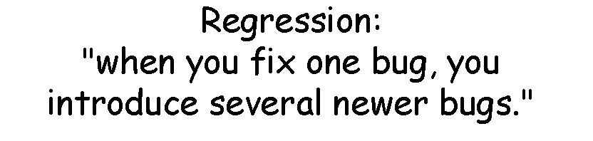
Regression Testing
Goal:
Assure that software functionality that previously worked as desired didn’t stop working;
Re-running previously run tests;

Slide 13
Quiz
1. Describe the relationship between Unit, Integration and System testing.
2. Describe the goal of unit testing.
3. What kinds of testing belongs to System testing?
4. What is Change testing? Please, describe the goal of Change testing.
5. What is the goal of Regression and Exploratory testing?

Slide 14
Automated testing
Goal:
verify that software satisfies specified requirements;
detect and localize errors;
execute tests without manual intervention.
Manual – by running Manual Test Cases
Automated – by running Automated Test Cases

Slide 15

Definitions
Test Script is a set of instructions for automated testing of some application functionality.
Test Suite is a set of Test Scripts that are connected by functionality or goals.
Test Run is a set of Test Suites that are run together.

Slide 16
Advantages of Automated testing
Execution of regression Test Cases
Big count of tests can be executed more often
Execution of difficult / complex tests
Saving of resources for more interesting tasks
Consistency and repeatability of tests
Reusing tests
Quick time to market
Increased confidence in software

Slide 17

By Testing Object:
Functional testing
Performance testing:
Load
Stress
Usability testing
Time on Task, Accuracy, Recall, Emotional Response
GUI testing
Security testing
Confidentiality, Integrity, Availability
Localization testing
GUI testing
Boundary testing

Slide 18
Testing of program performance
Goal of Performance testing:
to determine how fast some aspect of a system performs under a particular workload
Goal of Load testing:
learn system’s behavior after subjecting a system to a statistically representative (usual) load
Goal of Stress testing:
to determine the stability of a given system under unusual workload

Slide 19
By Knowledge of the system:
Black box
White box
Grey box

Slide 20
By the time of testing:
alpha testing
smoke testing
new feature testing
regression testing
acceptance testing
beta testing

Slide 21
Quiz
1. What is the difference between the manual and automated testing?
2. Name the benefits of using automated testing tools.
3. Name the different kinds of testing depending of a testing object.
4. Please, describe Performance, Load and Stress testing.
5. Please, describe the main aspects of Usability testing.
6. What kinds of testing do you know depending on time?
7. What kinds of testing are belongs to alpha testing? Describe them.
7. What is White Box, Black Box and Grey Box testing? Describe them.

Slide 22
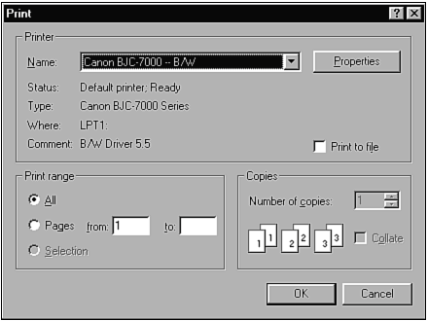
Boundary testing - Questions
Start up Windows WordPad and select Print from the File menu. You'll get the dialog similar to shown in the picture below. What boundary conditions exist for the Print Range feature shown in the lower-left corner?

